Slide 1
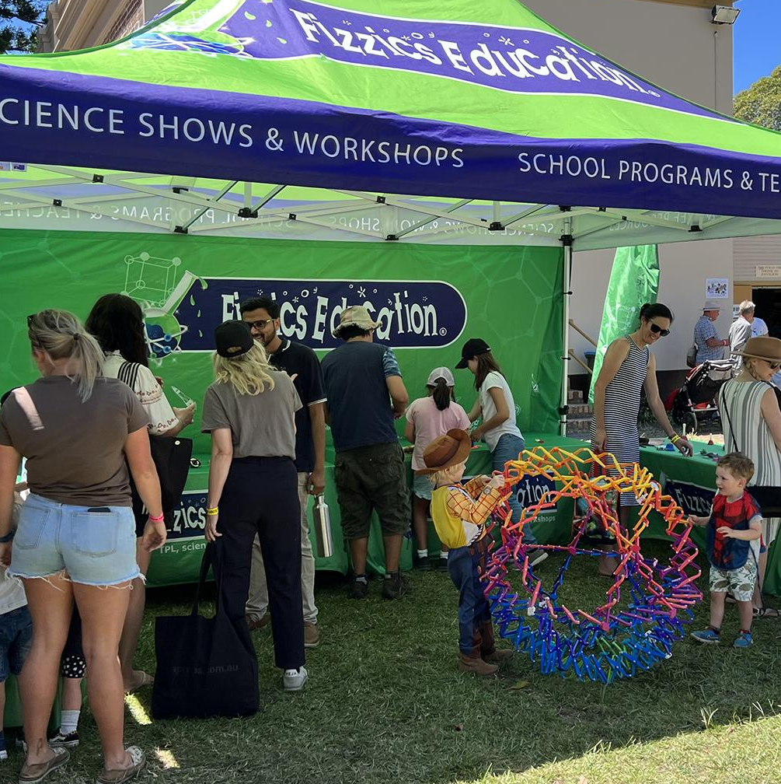
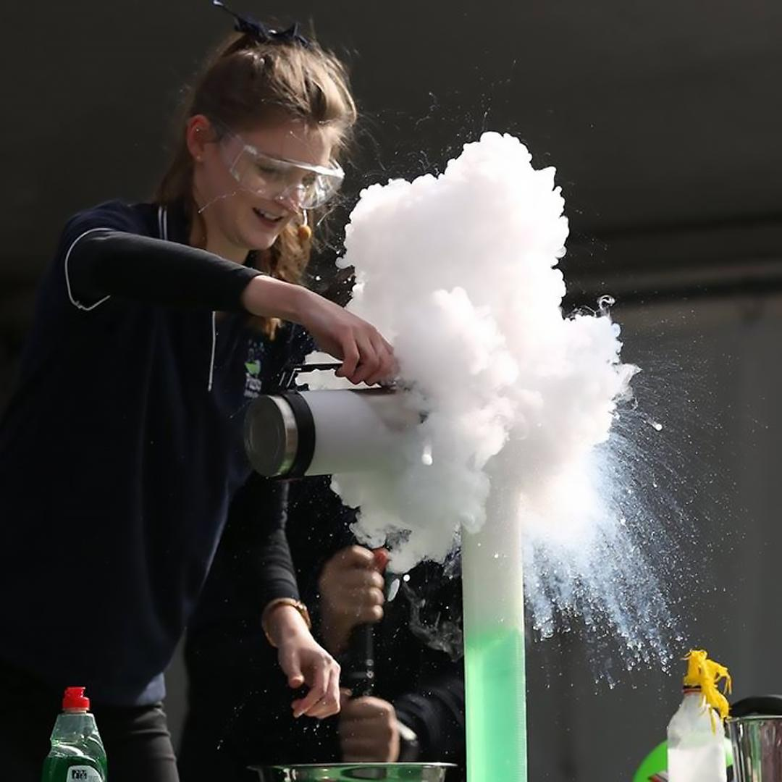
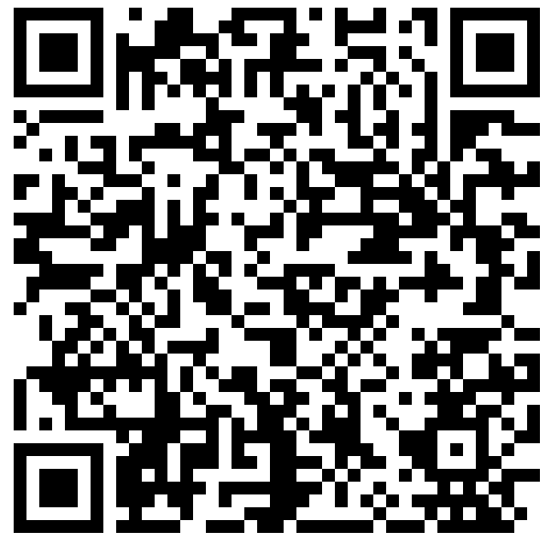


Slide 2
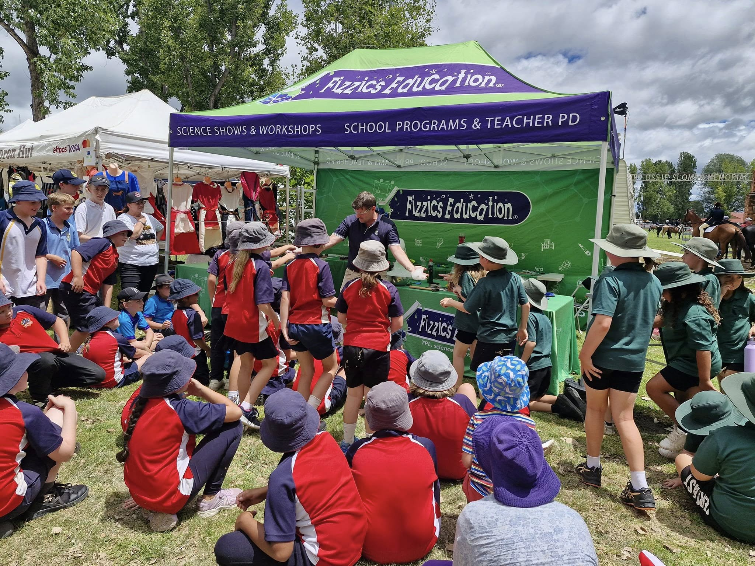


Slide 3

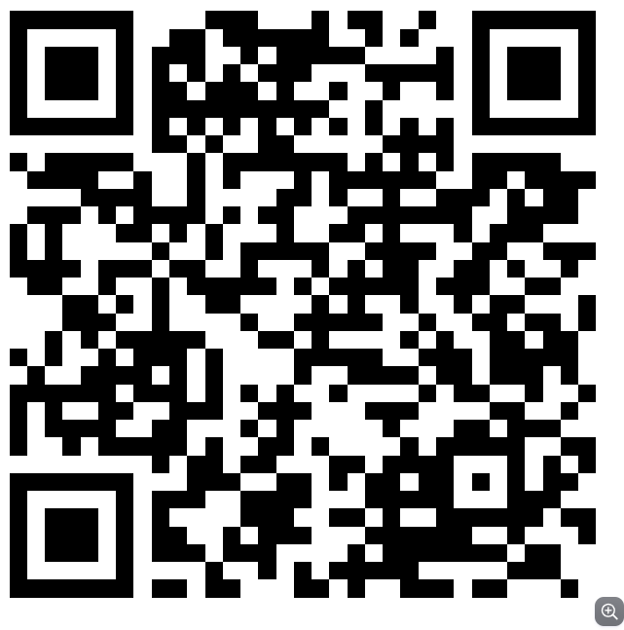
NSW Curriculum links
https://curriculum.nsw.edu.au
/learning-areas

Slide 4
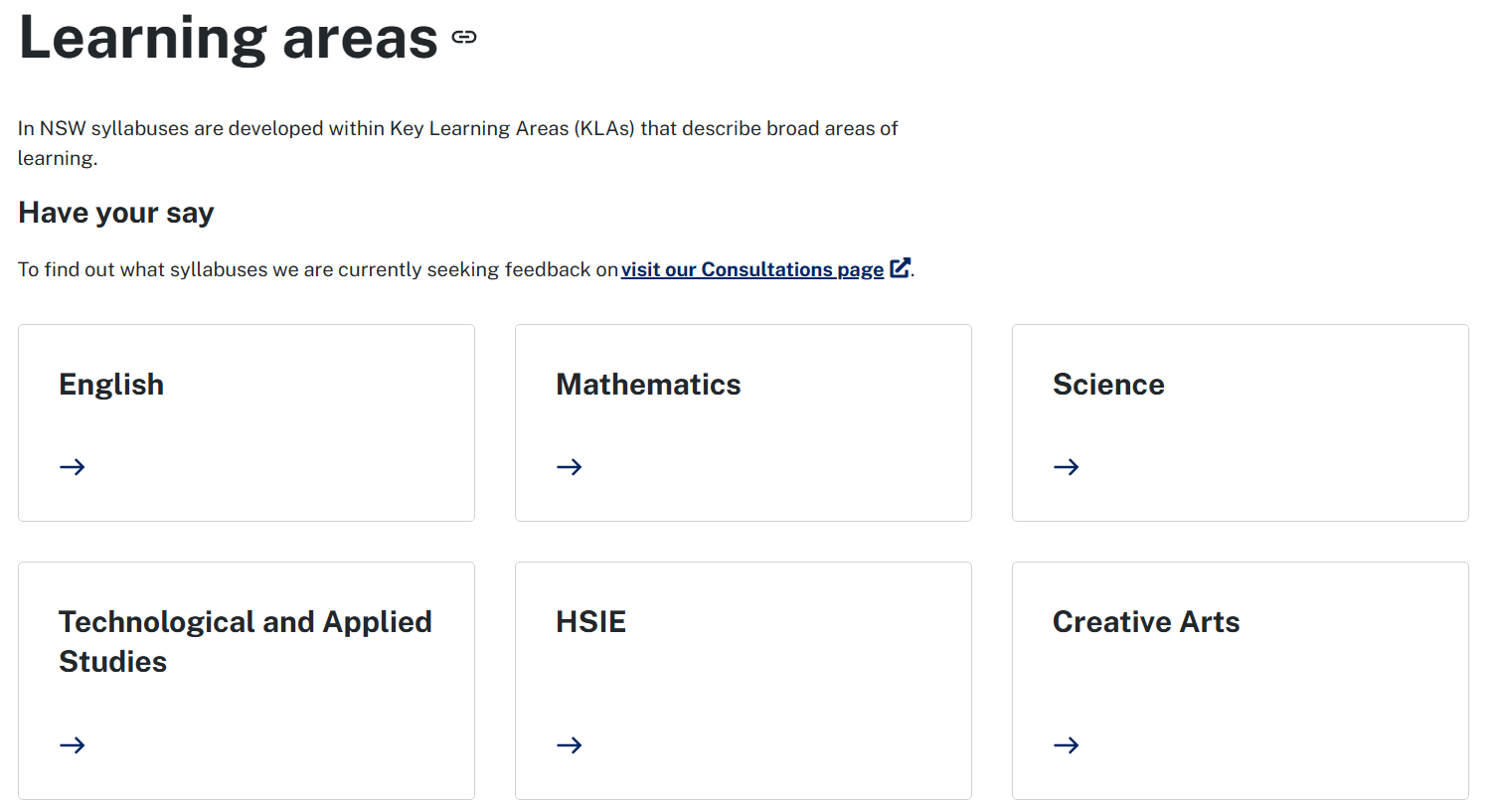

Slide 6
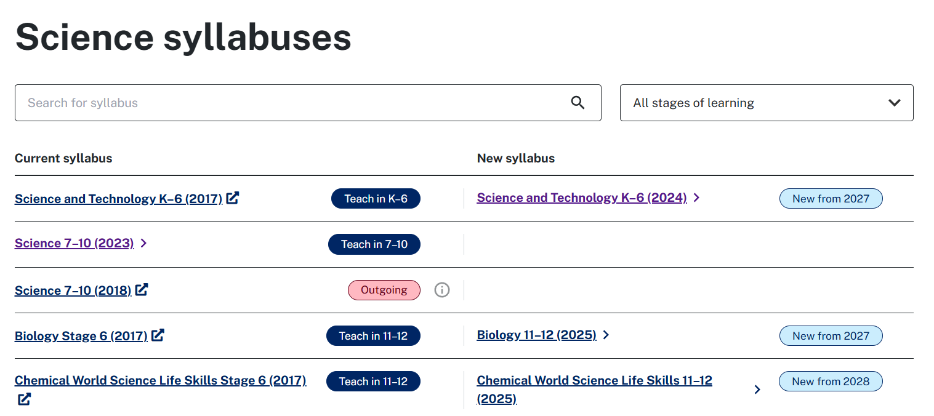

Slide 8
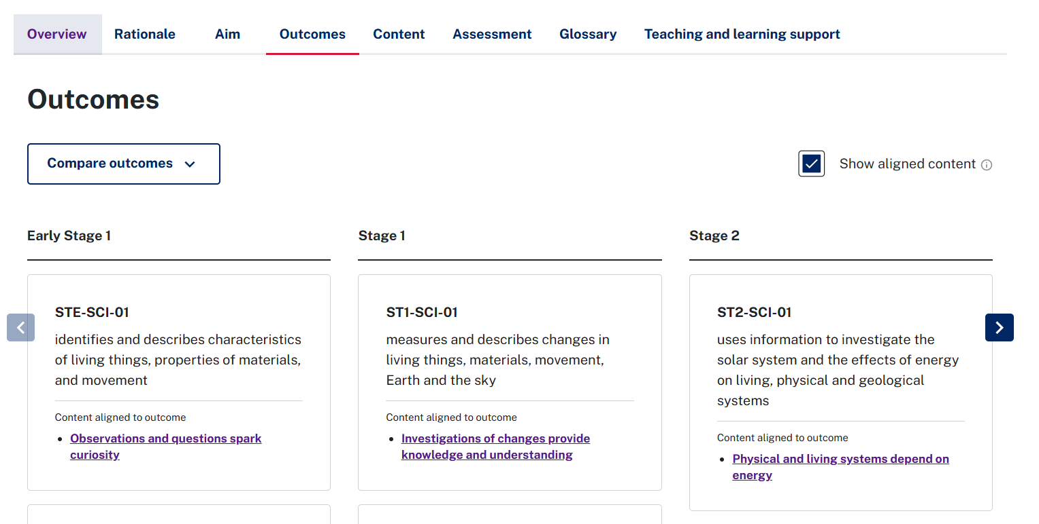

Slide 12
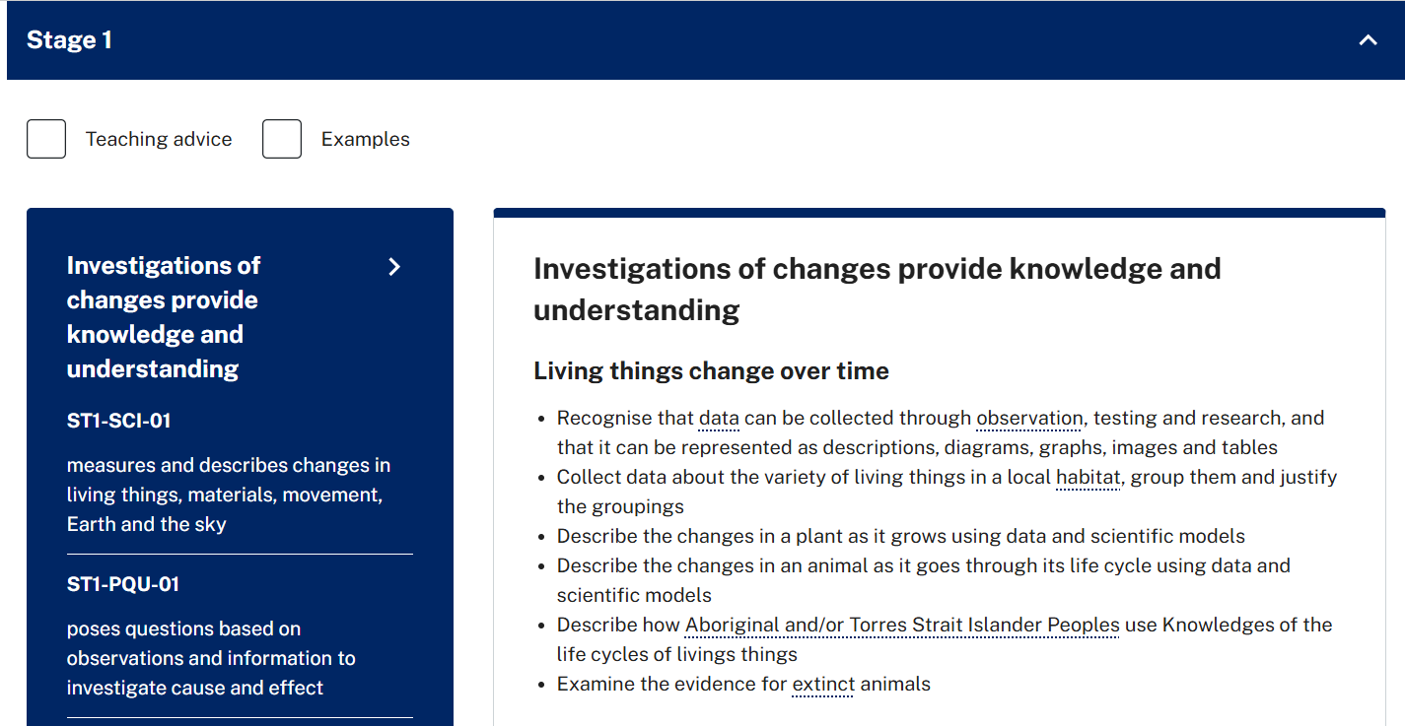

Slide 15
Stage 1 (Grades 1 & 2)
ST1-SCI-01
measures and describes changes in living things, materials, movement,
Earth and the sky
ST1-PQU-01
poses questions based on observations and information to investigate cause and effect
Describe the changes in a plant as it grows using data and scientific models
Describe the changes in an animal as it goes through its life cycle using data and scientific models

Slide 16
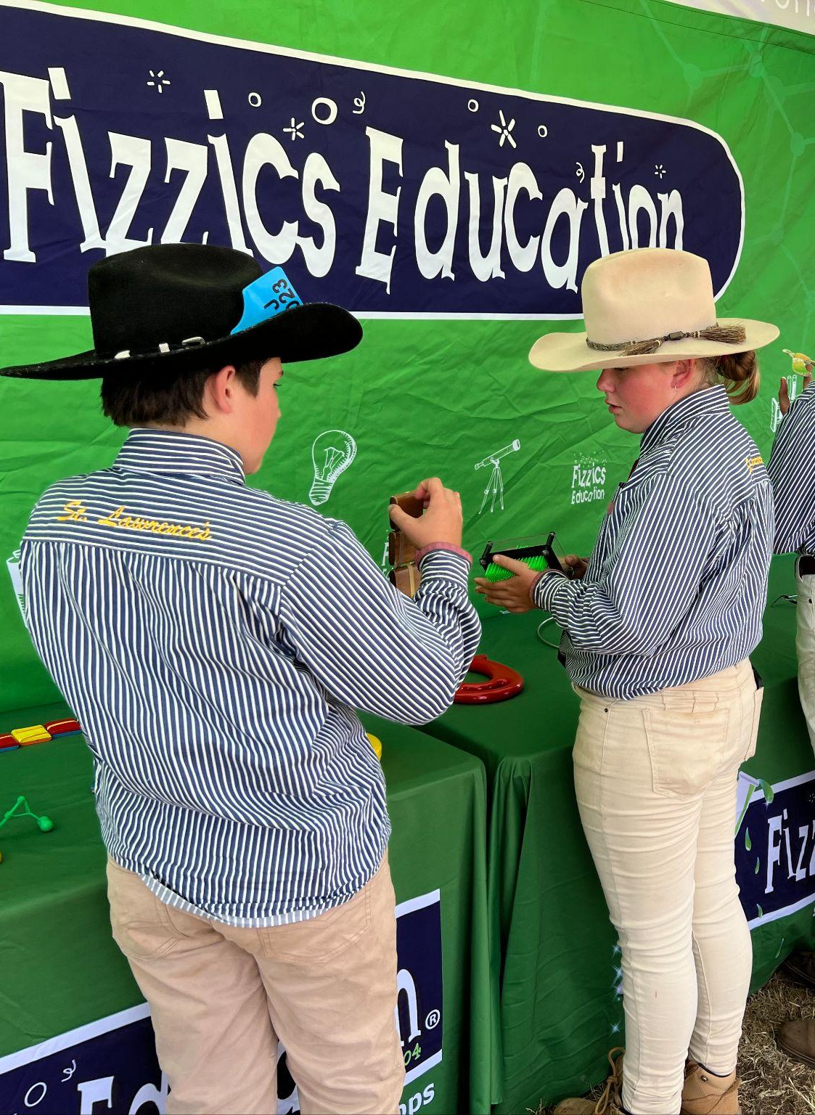
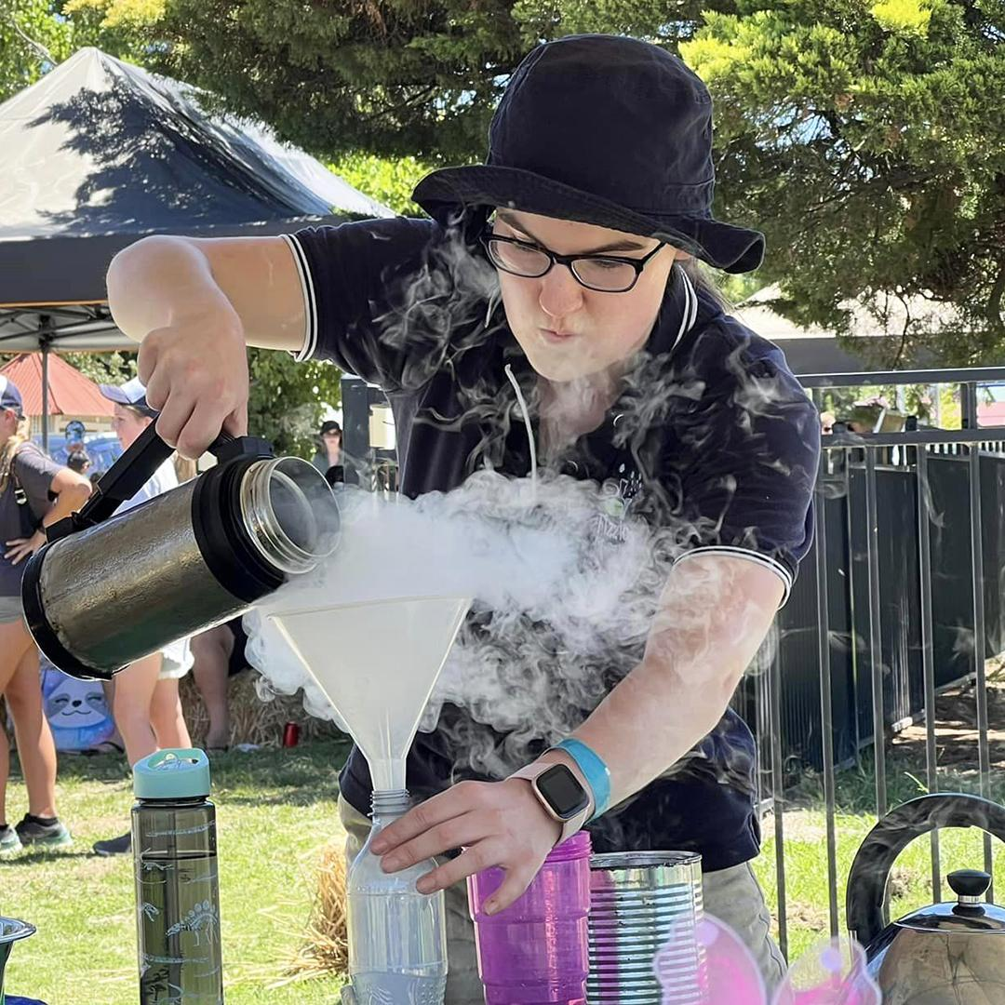
What helps schools
Curriculum links
Pre-visit & post-visit activities (teacher pack)
Timetable
Venue map (as a walking trail)
Bus drop off site
Value add:
> Bring industry/providers to their school the day prior
> Webinar speaker to schools the week prior

Slide 17
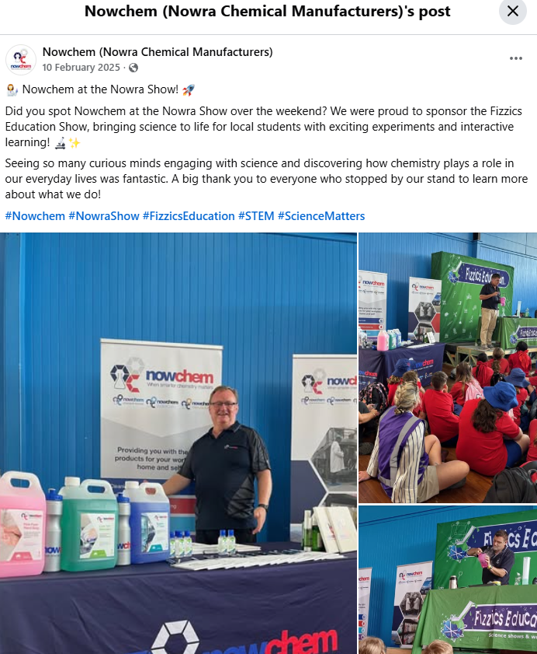
Engage with Sponsors

Slide 18
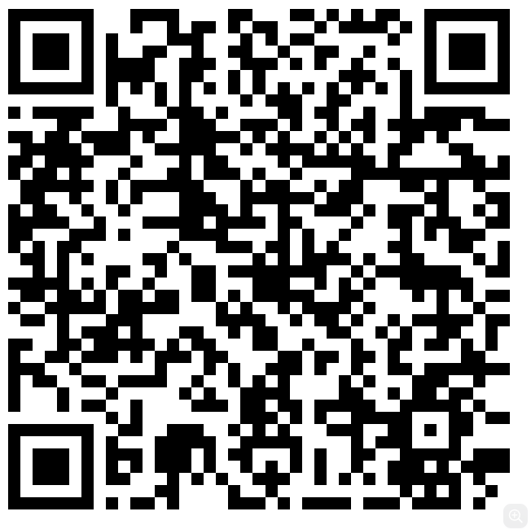
Supporting links
NSW Curriculum links https://curriculum.nsw.edu.au /learning-areas | How science supports agricultural shows https://www.fizzicseducation.com.au/articles/why-science-shows-workshops-work-at-an-agricultural-show/ | More on Fizzics Education at Ag shows. https://www.fizzicseducation.com.au/events-corporate/ agricultural-show-entertainment/

