Slide 1
FROM SURF TO
SHOWGROUND
Building Strong Volunteer Communities
Louise Cooke, June 2026

Slide 2
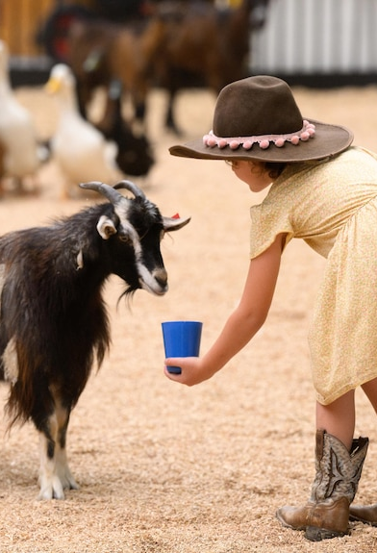
Both organisations…
Have strong traditions
Are hubs for community connection
Operate within a similar volunteer-led structure
Know that without volunteers, none of what we do happens
Notes:
History goes back to 1800’s – SLSNSW early 1900’s - both are trying to attract new generations while honouring those who built the organisation.
Agricultural shows are more than just events, Surf Life Saving is more than just patrols on the beach – they’re community hubs and platforms for education
AgShows has 189 Show Societies – SLSNSW 129 SLSCs all essentially running small businesses
Scale of volunteering in both organisations is huge – agricultural shows are supported by more 18,000 volunteers – comparable size to Surf Life Saving’s active patrolling volunteers
Have been leading work across Australia for 5 years investigating volunteer experience, what drives satisfaction and what drives decisions to leave the organistaion. Plan to share highlights of what we know, and some practical things that organisations can do to build on this knowledge to support the sustainability of what they do.

Slide 3
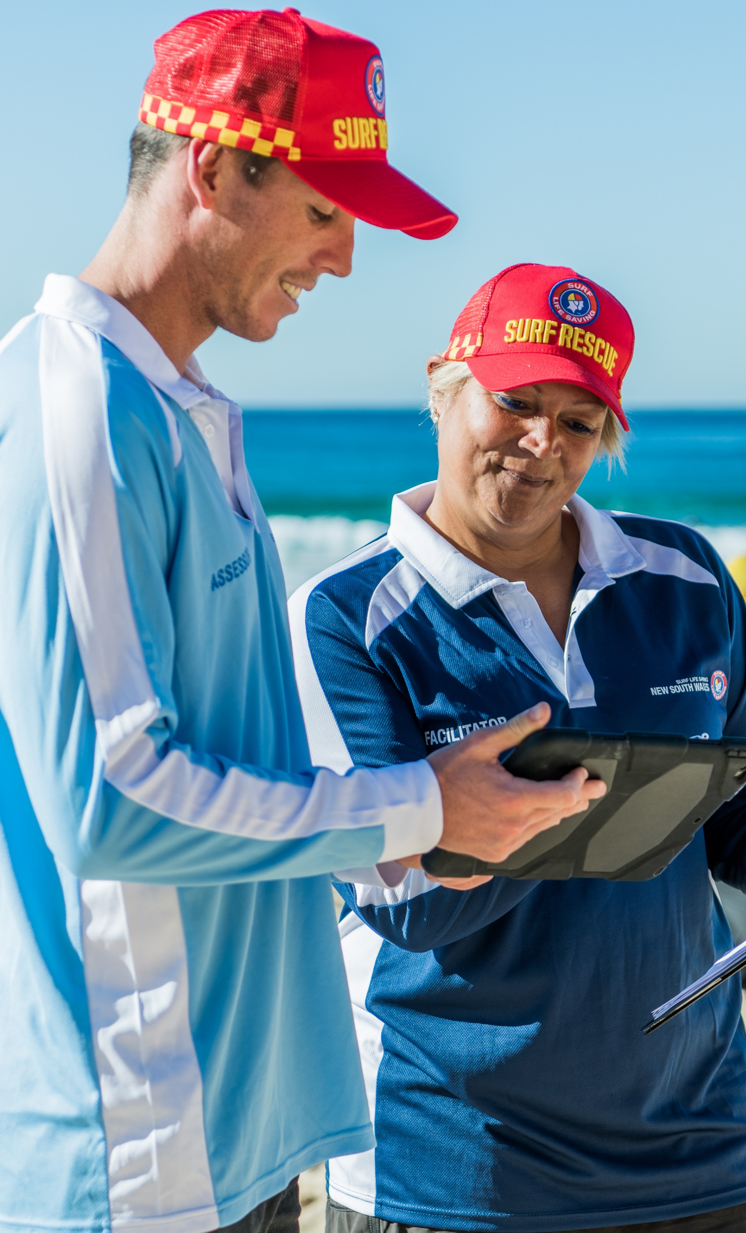
Our key challenges: Volunteering
Volunteering is on the decline – there is growing concern about the viability and sustainability of volunteering.
The trend towards professionalising volunteering has resulted in increased job demands – this has put strain on an often dwindling pool of volunteers.
The changing nature of volunteering, specifically a growing trend towards episodic or ad-hoc volunteering, is at odds with the demands of many volunteer roles.
Notes:
Organisations with comparable reputations and activities compete over the same pool of volunteers. Coupled with the changing nature of volunteering, there is growing concern about the viability and sustainability of volunteering.
Increasing job demands (specifically training, administration and regulatory requirements).
This contexts makes it critically important that we understand how we can attract and retain volunteers. SLSNSW adopts an evidence-based approach…

Slide 4
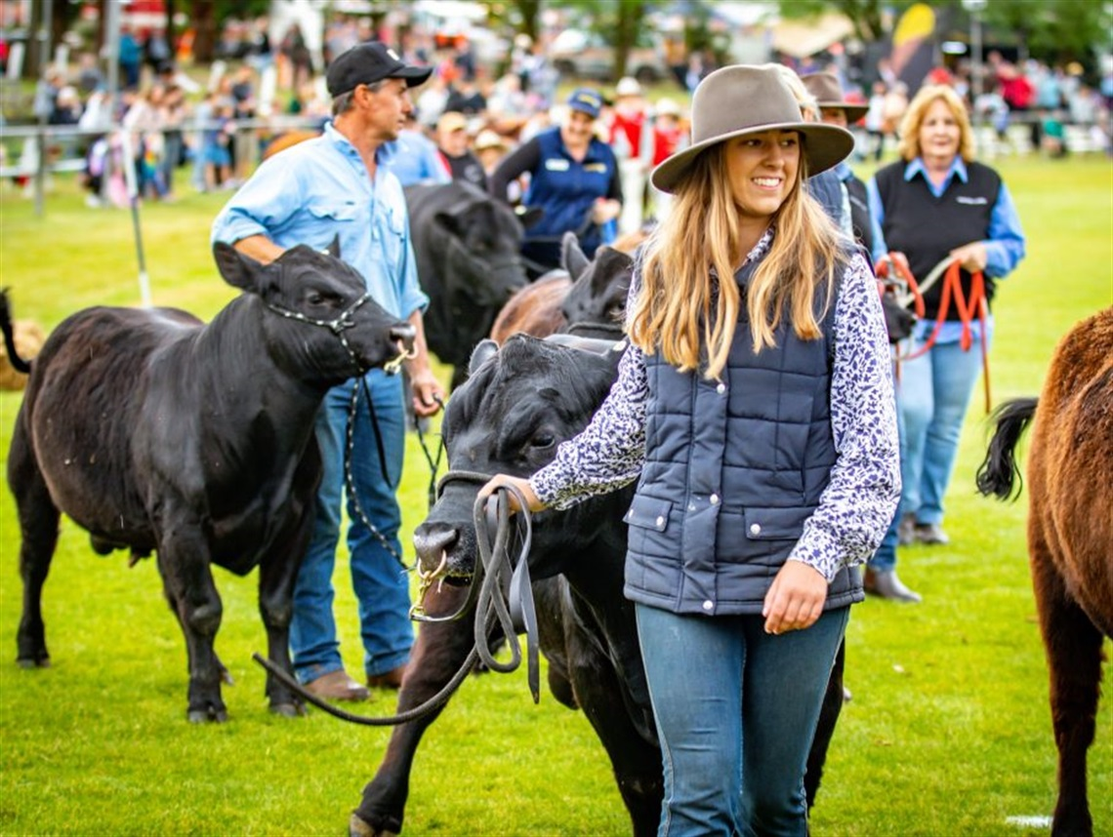
Volunteer recruitment
Most people join as a volunteer because they were asked or because they knew someone in the organisation.
A decision to join an organisation depends on the perceptions of that volunteering organisation.
There are very few intergenerational differences for the reasons to volunteer (to give back to the community and for the content of the volunteer work).
Motivations can change over time.
Notes:
Few people join because they saw recruitment material in the media or because they looked for the opportunity themselves.
What does this mean for us?
Our people are the greatest recruitment tool we have
Our brand – our story, our values, and how they are brought to life through the experiences and interactions we create – matters
Role design – what we ask people to do when they’re volunteering – matters
Simply getting volunteers through the door in the first place isn’t enough

Slide 5





HEADLINES:
DRIVERS OF SATISFACTION
Autonomy need satisfaction
Integration of differences
L&D quality
Inclusion in decision making
Motivational leadership
Notes:
Research with almost 8,000 Surf Life Saving volunteers across Australia
Volunteers are most satisfied when they:
• are free to be themselves, make decisions, and have choices in how they carry out their role (Autonomy #1)
• feel that people’s differences are respected and valued in their club (Integration of differences – inclusive climate #2)
• receive useful, relevant, and sufficient training and development (L&D quality #3)
• are included in decision-making at their club (Inclusion in decision-making #4)
• experience motivational leadership from SLS leaders — positive interpersonal leadership behaviours that are supportive, satisfy volunteer needs, and provide an optimally motivating climate (Motivational leadership #5
Note about induction

Slide 6
Volunteer Retention at SLS
People join to help the community or learn new skills – whether they stay depends on the culture.
Strategically, we focus on leadership development at all levels
Motivational leadership
Notes:
People join to help the community or learn new skills – whether they stay depends on the culture.
Strategically, we focus on leadership development at all levels:
Motivational leadership
Inclusive leadership

Slide 7
SELF-DETERMINATION THEORY

Slide 8
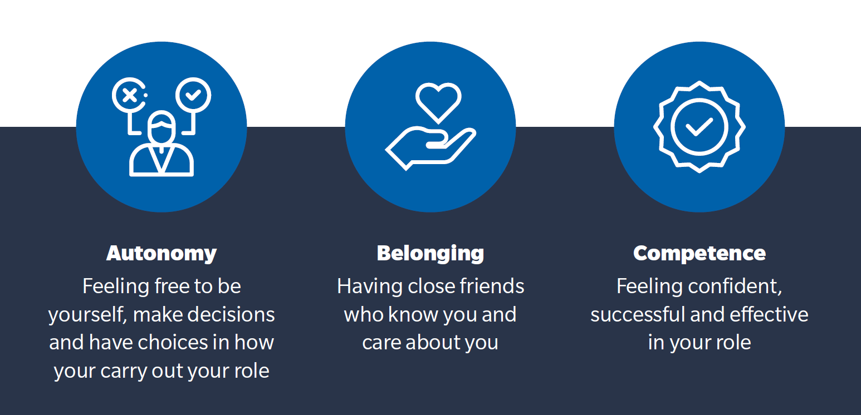
SELF-DETERMINATION THEORY

Slide 9
SELF-DETERMINATION THEORY

Slide 10
SELF-DETERMINATION THEORY

Slide 11

Volunteer Retention at SLS
People join to help the community or learn new skills – whether they stay depends on the culture.
Strategically, we focus on leadership development at all levels
Motivational leadership
Inclusive leadership (in progress)
Recognition
Notes:
Reference to Awards taking place

Slide 12
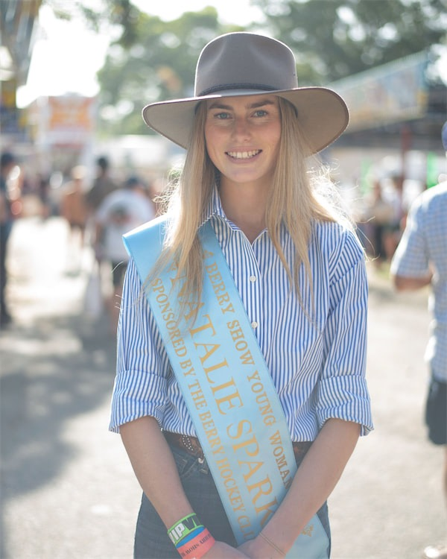
Youth Volunteering
To develop skills and knowledge
To have fun with their friends in a welcoming environment
To feel heard and involved at their club, being given an active role in the club community
Recognition of their services and commitment
Notes:
Just last year launched a new 5-year Youth Strategy – sharing what young people told us they want from us…
Social events throughout the SLS Season. As well as awards, qualifications and pathways to leadership roles.

Slide 13
FROM SURF TO
SHOWGROUND
Questions?
Louise Cooke, June 2026

