Slide 1
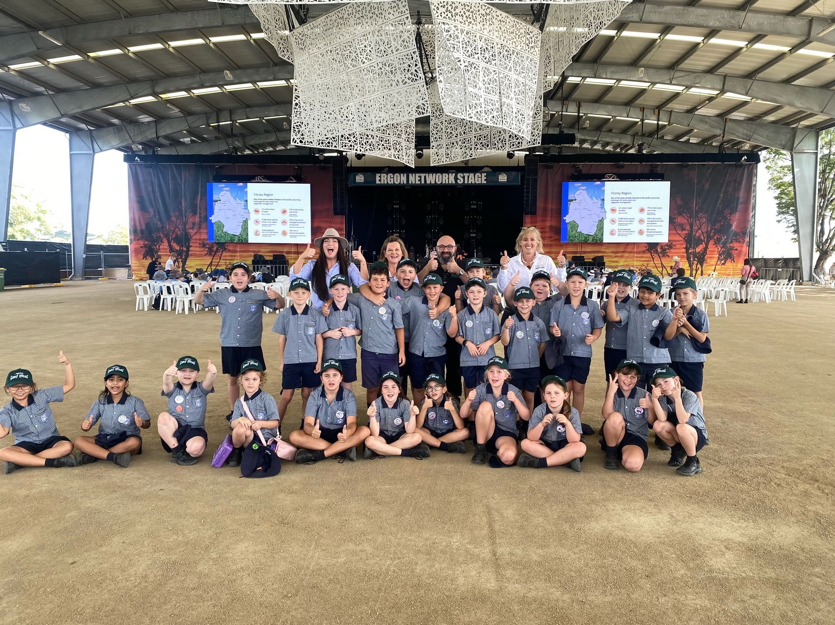


www.PIEFA.edu.au
Luciano Mesiti
PIEFA CEO
Primary Industries Education Foundation Australia
PIEFA
THE PEAK BODY FOR FOOD AND FIBRE EDUCATION IN AUSTRALIA
Celebrating Ag Shows 2026

Slide 2
Who is PIEFA?
PIEFA is a not-for-profit foundation formed through a collaboration between the Australian Government, primary industries organisations and the education sector. Through a range of online and in-person programs, PIEFA enhances food and fibre knowledge and understanding to young Australians through the development and promotion of:
Primezone
Primezone Academy
National Food & Fibre Education Leadership
Classroom Educational Resources
Teacher Professional Development
Career Pathway Information
PIEFA provides national leadership and coordination of initiatives to encourage primary industries education in schools through partnership with industry, government and educators;
In collaboration with industry partners, PIEFA’s team of Education Officers (experienced teachers) write and develop a range of highly engaging, curriculum-aligned food & fibre classroom resources.
To support teacher confidence in their ability to teach food & fibre content to students, PIEFA complements their classroom resources with Teacher Professional Development.
Through the Career Harvest website, students and careers advisors can discover scholarships, pathway information and other opportunities to succeed in a career in the primary industries.

Slide 3
About the Platforms
PRIMEZONE.EDU.AU / Primezoneacademy.edu.au
CAREERHARVEST.COM.AU
🌾 PRIMEZONE & Primezone Academy
🎯 CAREER HARVEST
Australia's leading food & fibre education platform
✅ Free curriculum-aligned lesson plans
✅ Primary & secondary resources (K–12)
✅ Managed by PIEFA
✅ National Careers Week resources
✅ SFIRP Digital Learning Kits
Australia's dedicated ag careers discovery hub
✅ 16 industry career hubs
✅ Career videos, Q&A panels & case studies
✅ Teaching resources for careers advisors
✅ Scholarships & tertiary pathways
✅ Job boards & AgCAREERSTART
✅ State-by-state career portals
Both platforms are projects of the Primary Industries Education Foundation Australia (PIEFA)

Slide 4
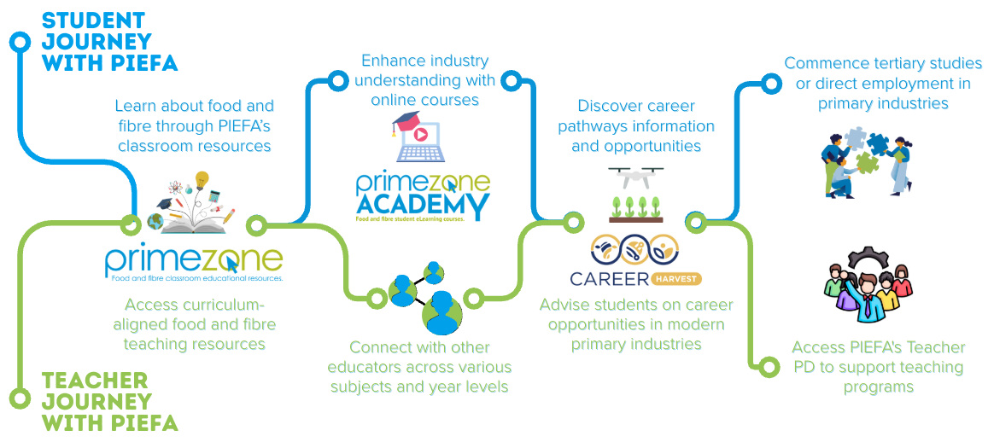
FROM CLASSROOM TO CAREER
Through our trusted platforms - Primezone, Primezone Academy, and Career Harvest - PIEFA inspires learning, builds industry knowledge, and encourages pathways into rewarding careers in primary industries.

Slide 5


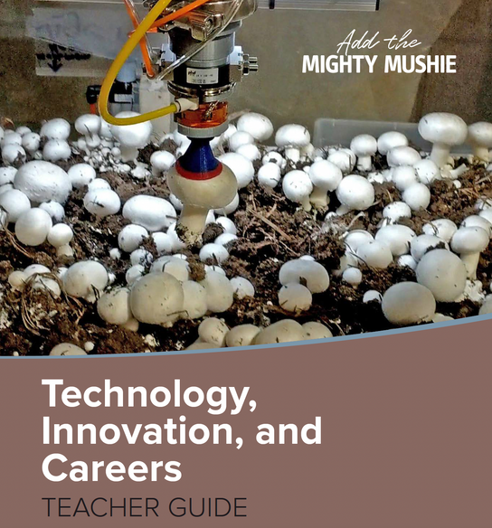



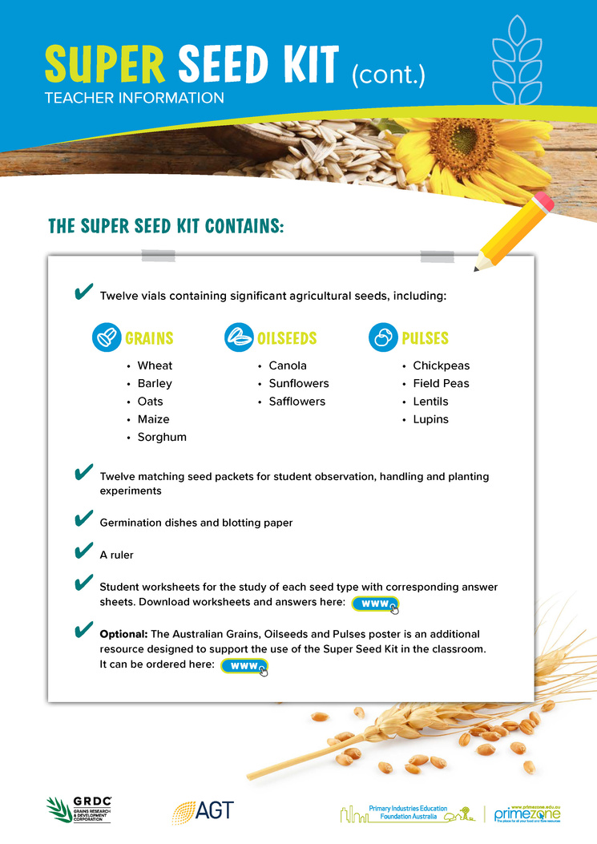



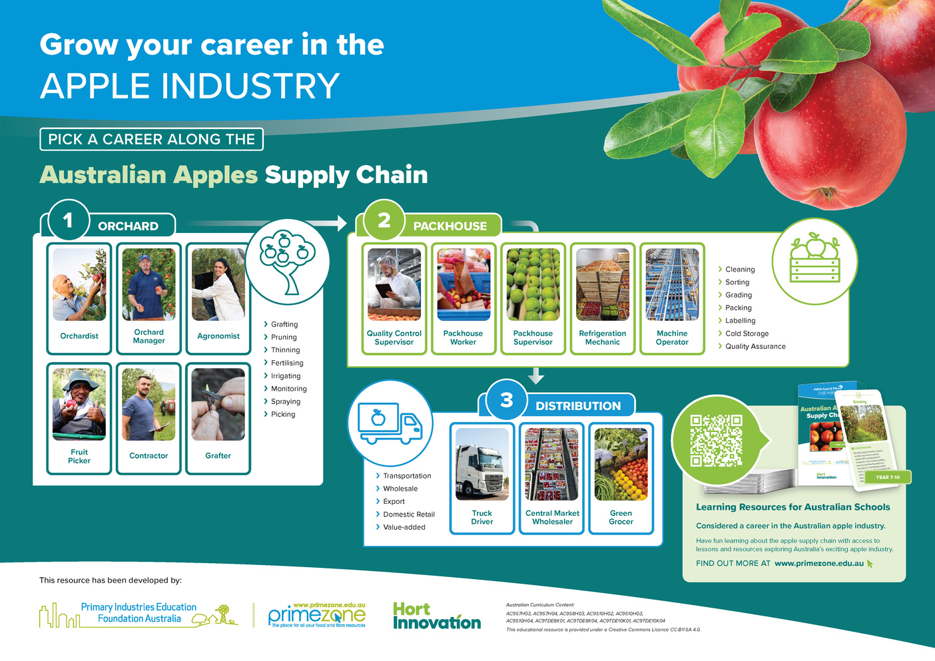
Free, cross-curricula primary and secondary resources on PIEFA’s Primezone website:
www.primezone.edu.au
www.primezoneacademy.edu.au
CLASSROOM RESOURCES

Slide 6

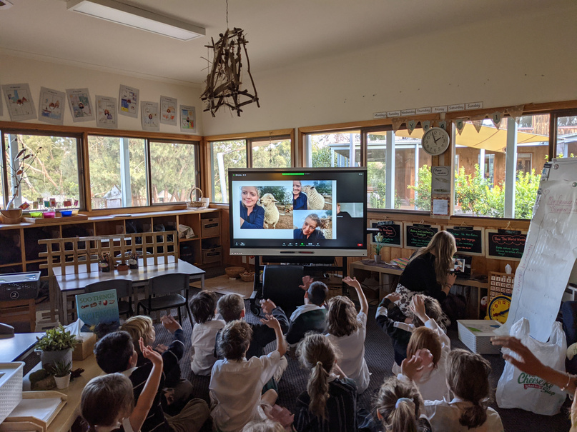
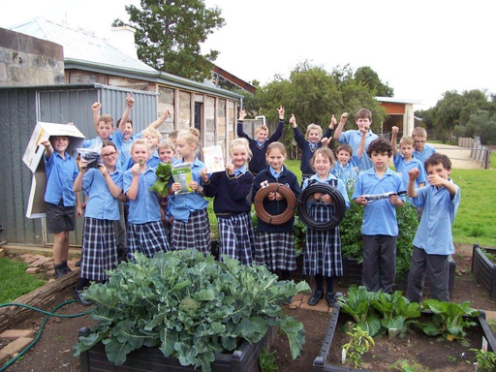
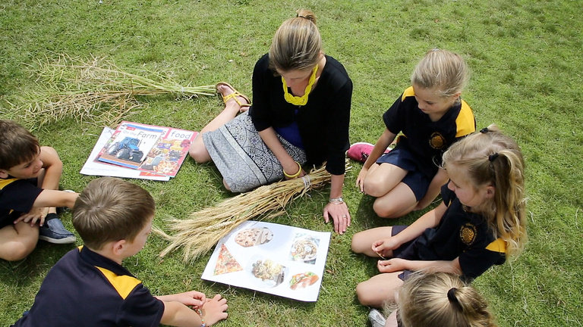
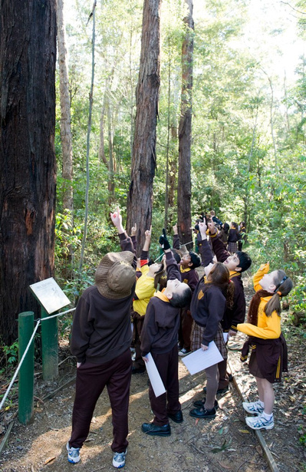

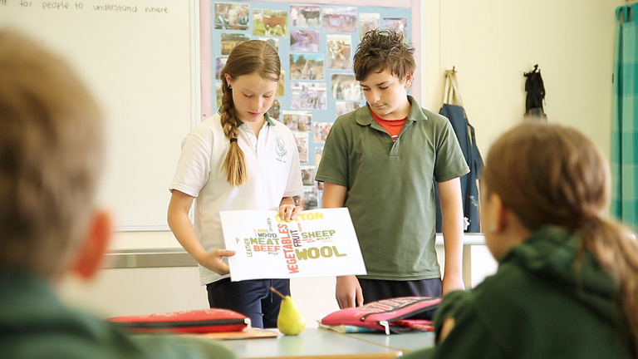
THANK YOU!
CONTACT: Luciano Mesiti, CEO
ceo@piefa.edu.au
Sign-up to PIEFA’s monthly newsletter.

