Slide 1

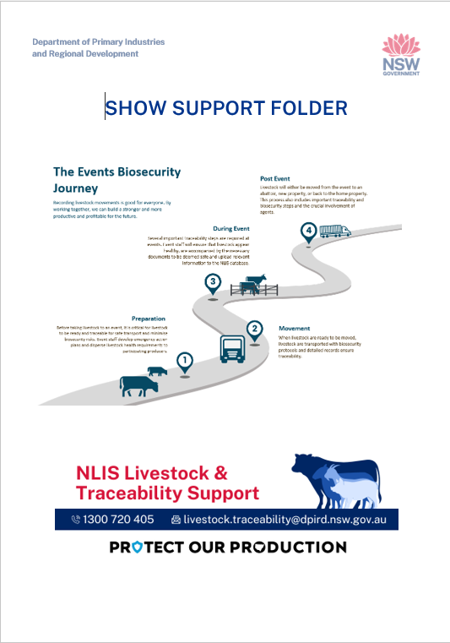
Show Support Folder
Department of Primary Industries
and Regional Development
Presenter: Kristy Garard
September 2025

Slide 2

The Department of Primary Industries and Regional Development acknowledges that it stands on Country which always was and always will be Aboriginal land. We acknowledge the Traditional Custodians of the land and waters, and we show our respect for Elders past, present and emerging. We are committed to providing places in which Aboriginal people are included socially, culturally and economically through thoughtful and collaborative approaches to our work.

Slide 3
Agenda
Department of Primary Industries
and Regional Development
Topic | Presenter | Time
1. Show support folder | Kristy Garard
2. Questions

Slide 4
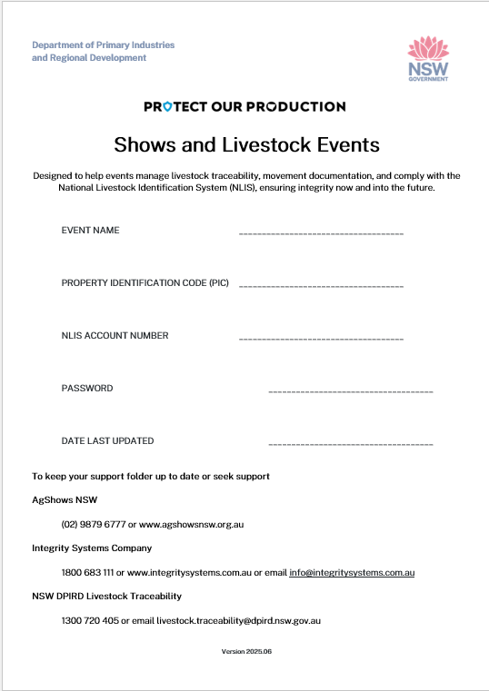
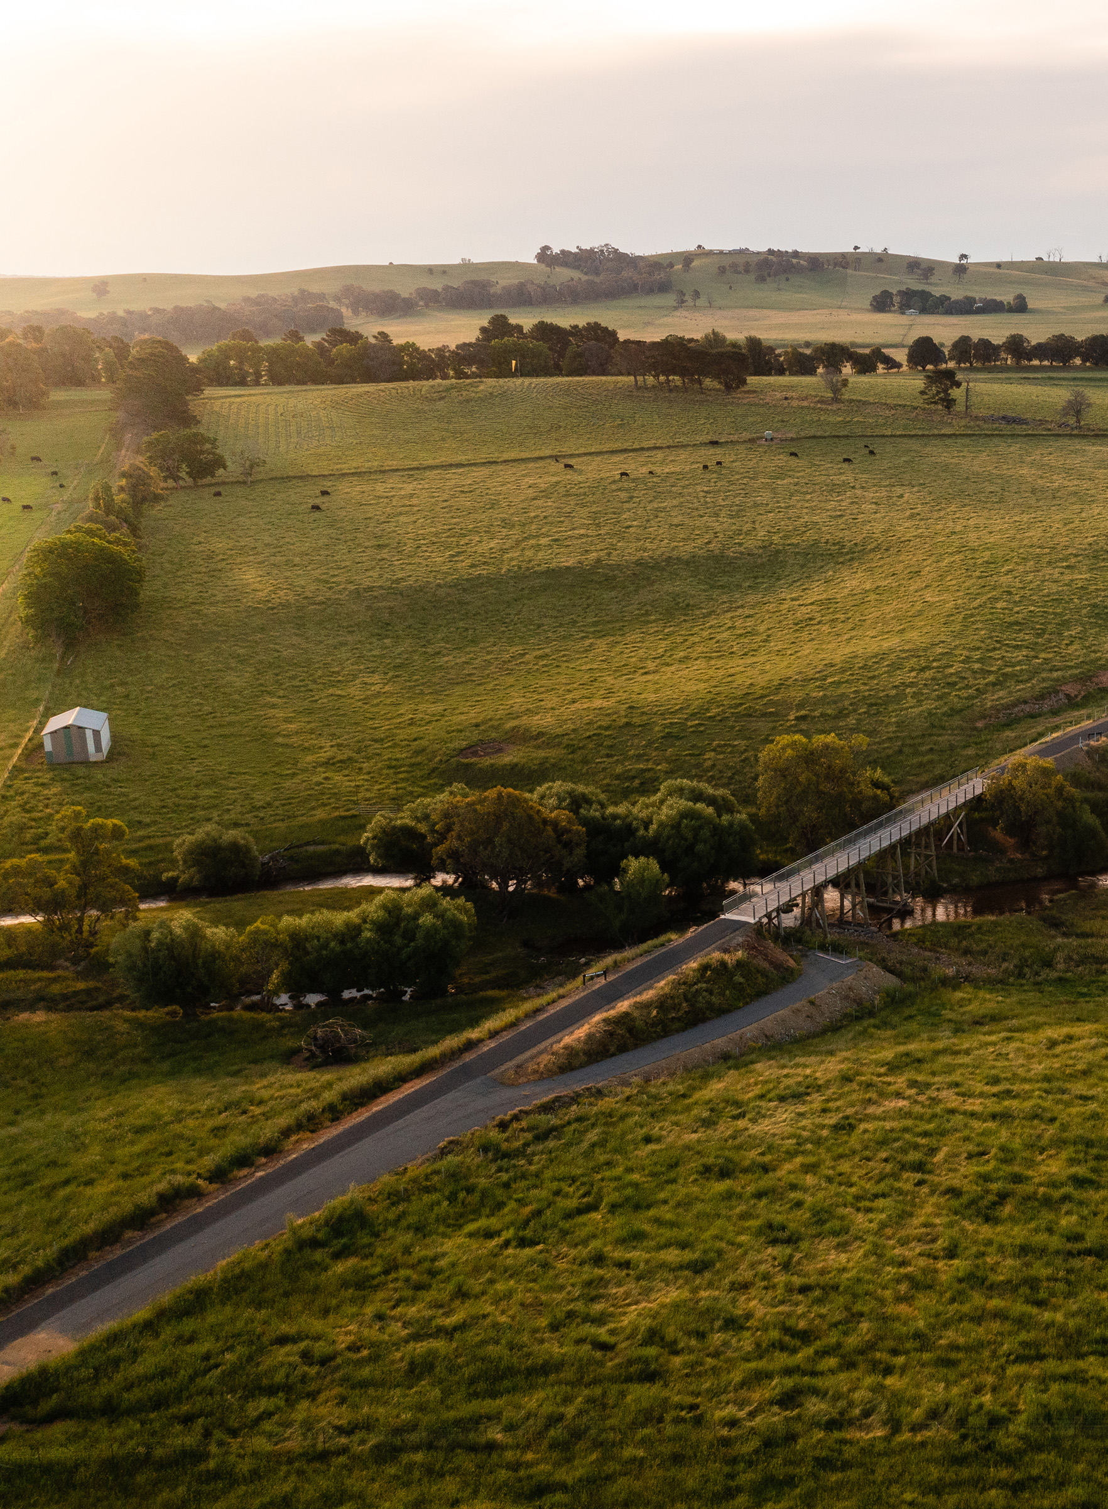
Introduction
Department of Primary Industries
and Regional Development
This folder has been developed by the Animal Biosecurity Traceability Team within the NSW Department of Primary Industries and Regional Development (DPIRD) to support your agricultural show.
It is designed to be a practical, easy-to-use resource for show committees, helping to meet National Livestock Identification System (NLIS) and livestock movement requirements.
Inside you’ll find helpful checklists and guidance to assist producers, stewards, and committee members with managing livestock attendance at shows.
We recommend storing the folder in the show office and reviewing its contents every 6–12 months. Please record the date of the most recent update on the front cover.
For the latest information and tools:
Visit the AgShows NSW website (under the Resources section).
Refer to the NLIS database ‘Tech Tips’ section under Help for current uploading instructions.
Contact DPIRD on livestock.traceability@dpird.nsw.gov.au or call 1300 720 405

Slide 5
Pre-Show Emails
NLIS Sporting Event Account – registered SPORTEVENT account
Awareness of Responsibilities – ensure all committee members understand NLIS responsibilities
Recording Livestock Movements – all movements to and from show must be recorded and uploaded into NLIS database within 2 days
Steps to ensure compliance
Property Identification Code (PIC) valid and active PIC where the show or event is held

Slide 6
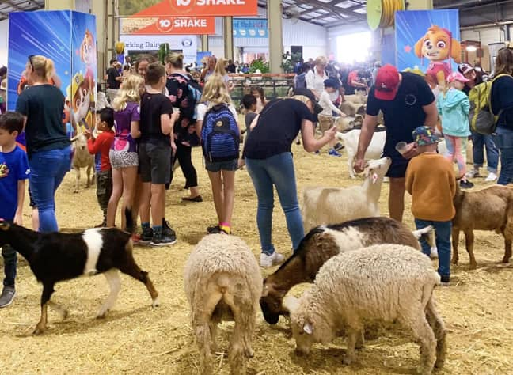
Petting Zoo/ Animal Nursery at your show or event.
If your show hires a registered business to provide a petting zoo or animal nursery, the animals are covered under the Exhibited animals Act - recording their movements is the business's responsibility.
If your show committee organises or supplies the animals for the petting zoo or nursery, then those animals must be tagged with NLIS approved identifiers and their movements recorded, just like any other livestock that attends your show.

Slide 7
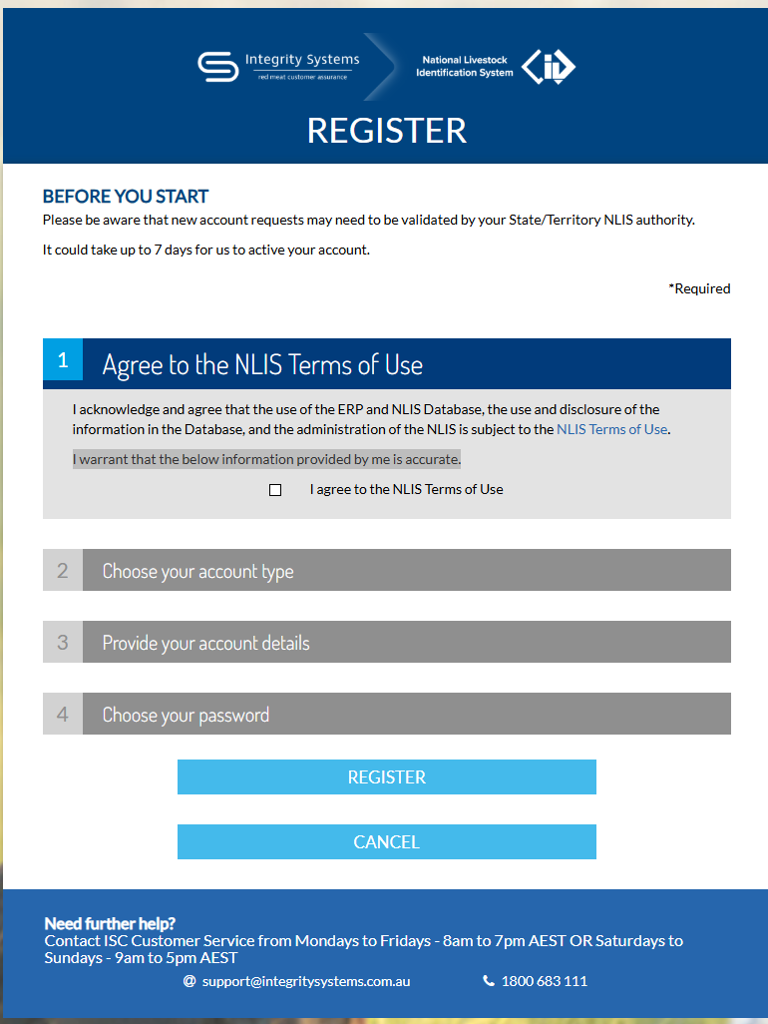
To meet your NLIS requirements and enable livestock movements to be uploaded into the NLIS database, you must register for a SPORTEVENT account via Register | NLIS - Australia's system for identification and traceability of livestock
As part of our AgShows Project, we are streamlining the process to help show society members obtain authorisation for these accounts more easily.
Applicants can be approved using one of the following methods:
By providing a valid show society email address, or
By having the show secretary send an email confirming their membership in the show society.

Slide 8
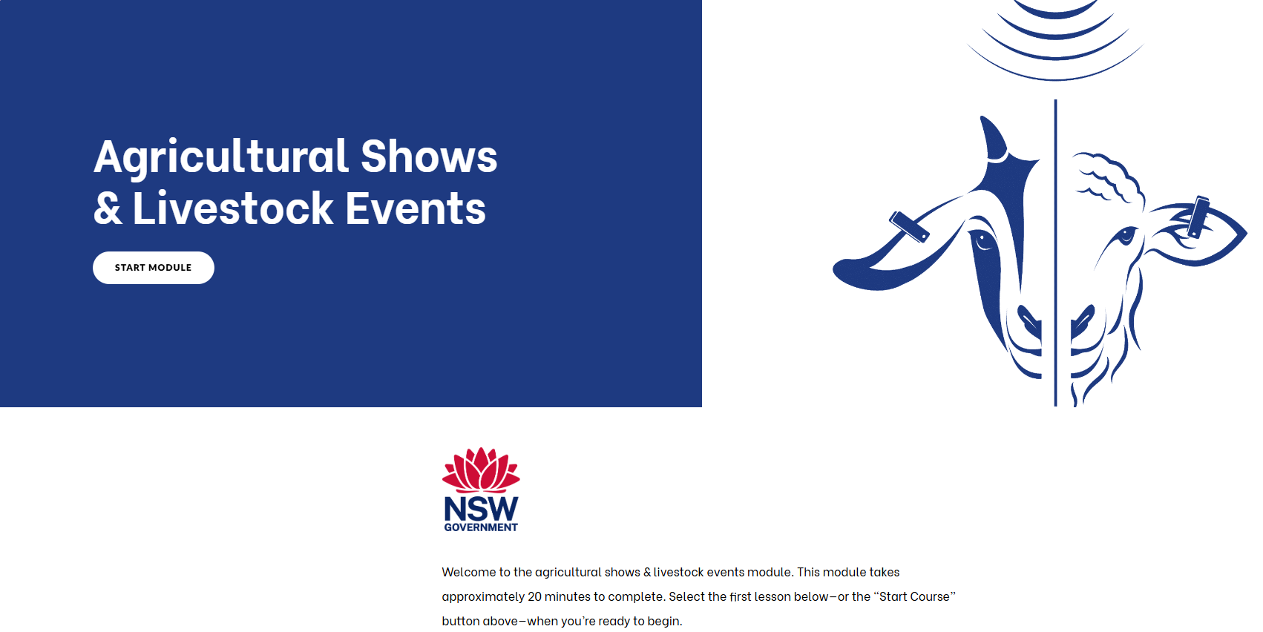
e-learning training module – Agricultural Shows & Livestock Events
Covers:
NLIS approved identifiers
When and what is changing for events and why it is important
Where’s woolly video Where's Woolly? on Vimeo
Tips to help prepare for the changes
NVD and TSS explained
During and after event responsibilities
Hoof and Hook
Where to go for help
To find the module, go to:
DPI website > Animals & Livestock > National Livestock Identification System > Sheep and
goats individual electronic identification > Training > Start eID training now
DPI website - Animals and livestock – NLIS - Sheep and goat individual electronic identification – Training - Start eID training now - Industry specific modules- Agricultural shows and livestock events

Slide 9
Key changes
Key changes effective 1 January 2025:
All sheep and goats born on or after this date must be tagged with an NLIS- approved electronic device before leaving their property of birth
Transition to Individual Recording by
1 January 2027
Use of Scanner or Wand
Shows to record and upload data
Mob-based movements will no longer be accepted.
A wand or scanner can significantly speed up and simplify the recording of livestock movements. You may be able to borrow one from your local LLS office or stock agent
Event organisers in NSW will also begin self-managing livestock records and uploading movement data directly into the NLIS database.
Movements of electronically tagged sheep and goats must be recorded individually in the NLIS database using the "Sighted Livestock" method if at a show for less than 3 days.
Sheep and goats without electronic tags can still be recorded as a mob movement until January 1, 2027.
If scanning is not possible, ensure that all NLIS-approved permanent identifier numbers (tags or RFIDs) are manually recorded on livestock record sheets.
All animals must be recorded individually in the NLIS database using their NLIS-approved identifiers.

Slide 10
DPIRD - Post-Show Emails
NLIS Data Upload
Livestock Movements: all movements uploaded into database within 2 days of movement
Confirmation of Data Upload: confirm upload is complete
Error Reporting: contact NLIS support team or DPIRD for assistance
Retention of Records: records need keeping for a minimum of 7 years
Additional support:
DPIRD and AgShows Website
e-learning training module specifically for shows and events – Agricultural Shows & Livestock Events

Slide 11
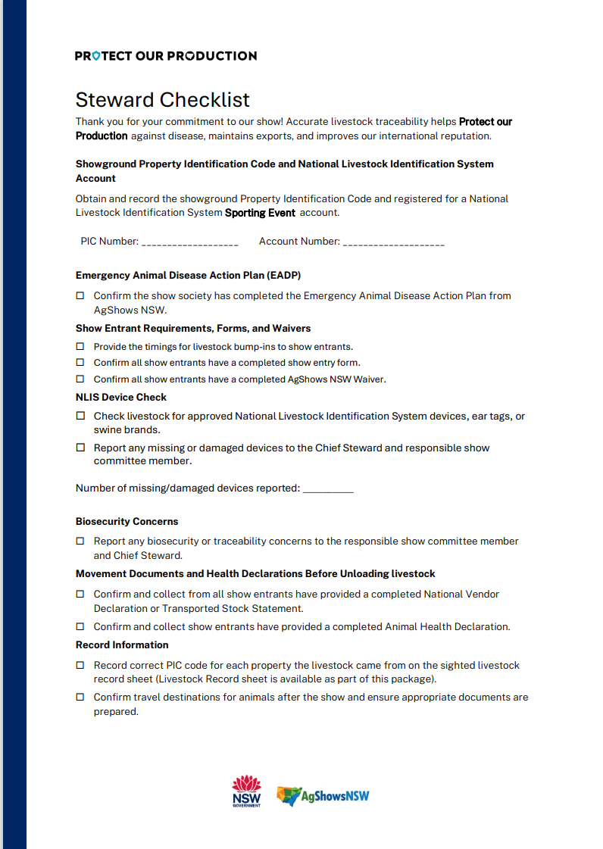
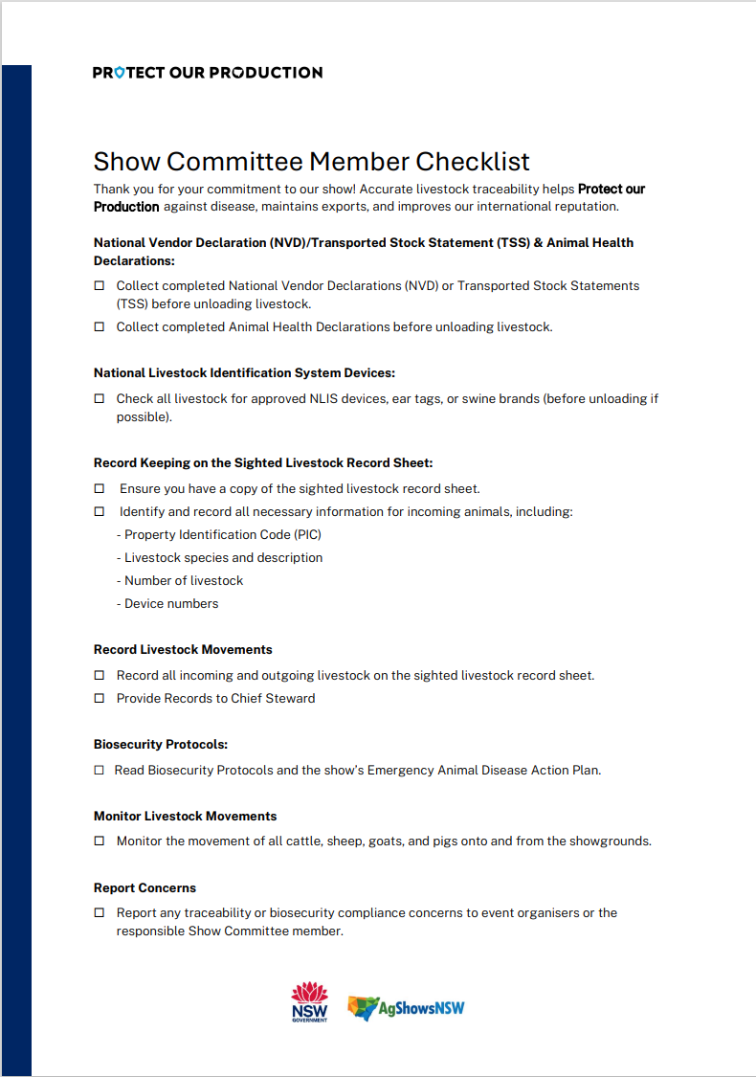
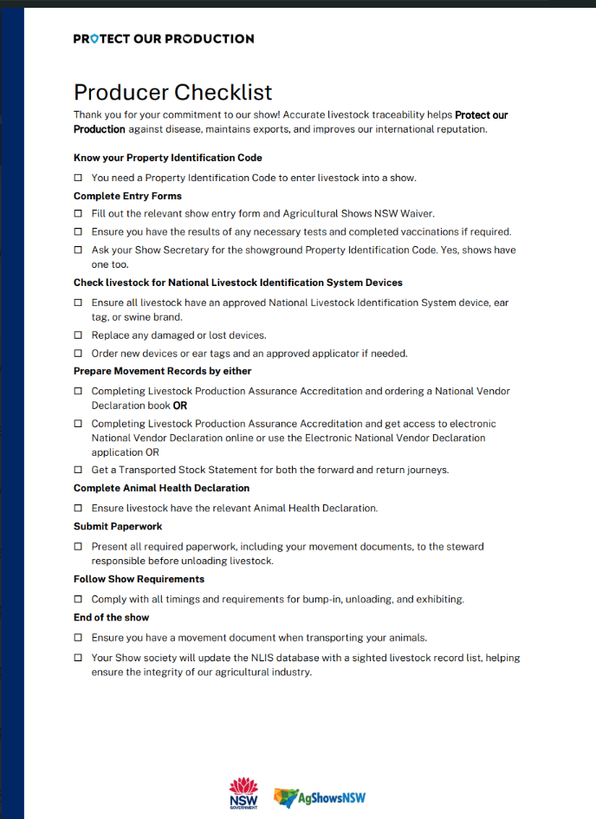
Checklists
Lorem.

Slide 12
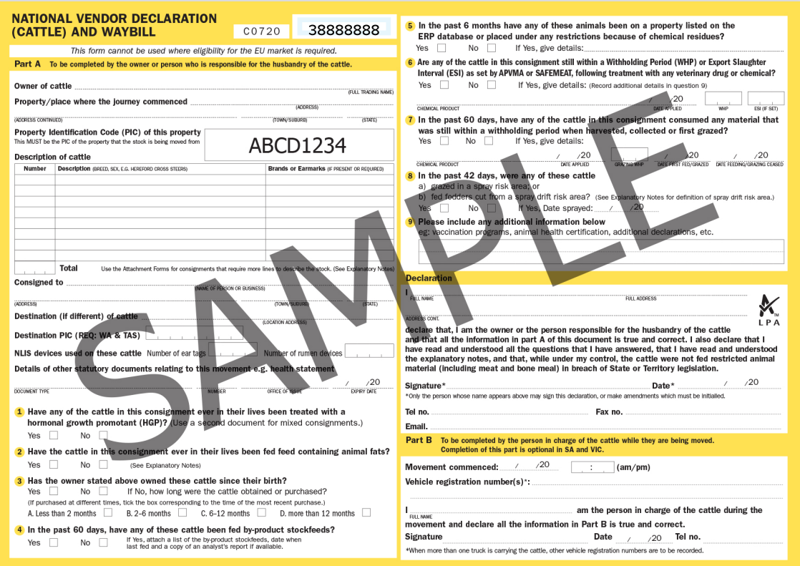
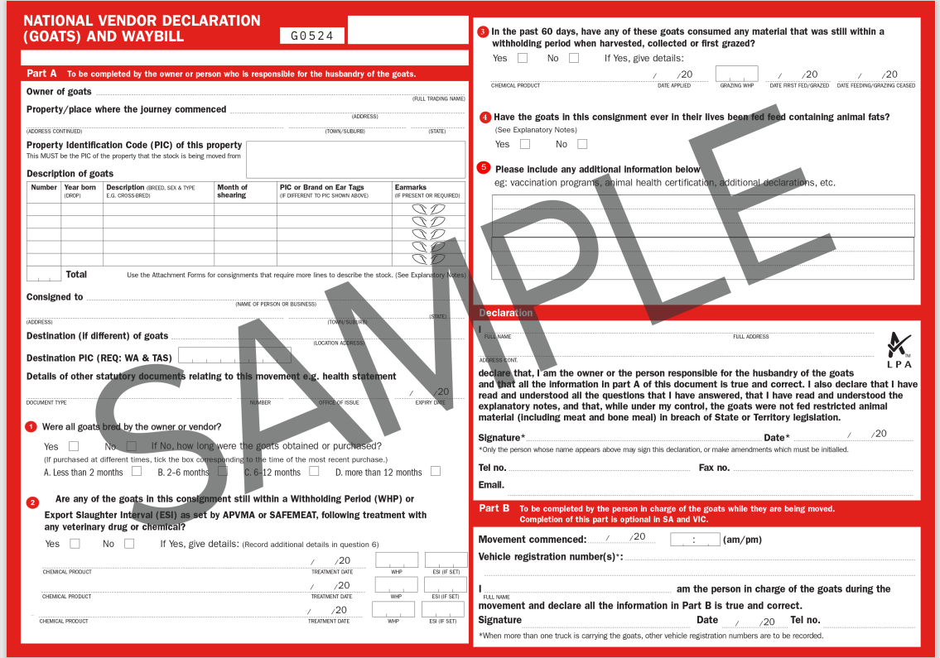
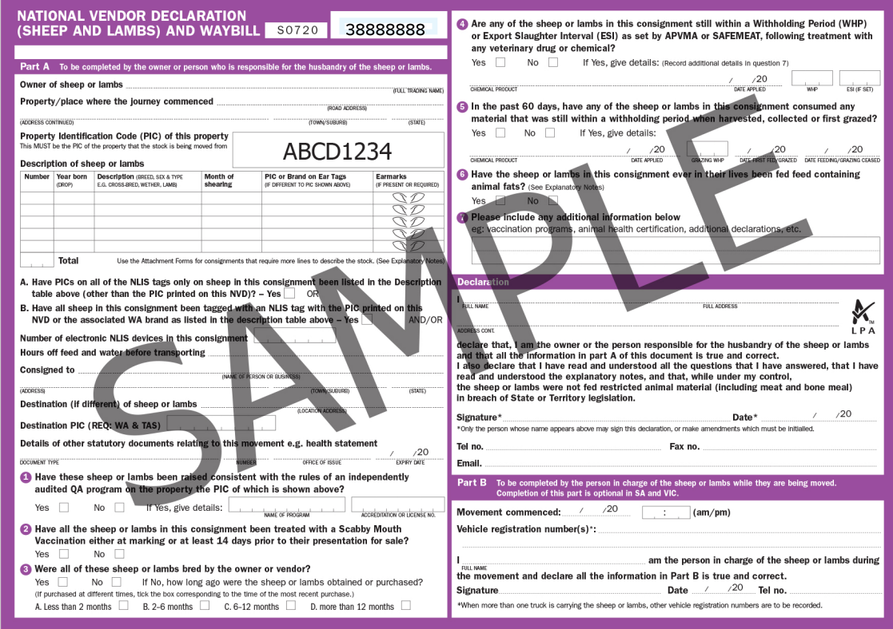
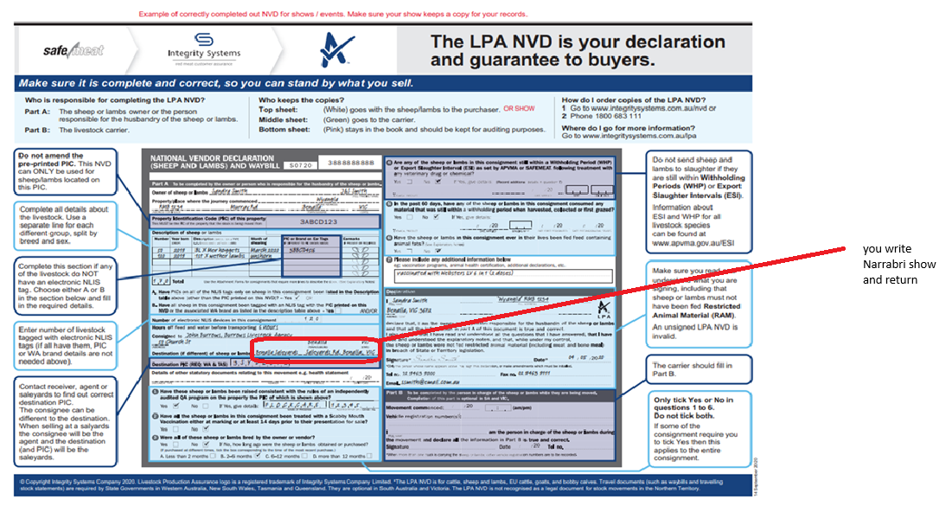

Slide 13
Options for meeting NLIS obligations
Currently, event organisers have two options for meeting their NLIS obligations:
Option 1: Upload livestock movements directly into the NLIS database
Option 2: Complete a livestock record sheet and submit to AgShows NSW or DPIRD

Slide 14
Uploading livestock movements methods
Method 1: 'Sighted Livestock'
Use this method if:
Livestock were on the event ground for three days or less, and
are returning to the same property they arrived from after the event or
participated in a “hoof and hook” competition and are later consigned to an abattoir for slaughter.
This method does not require entering the consignment or destination PIC, reducing data entry for event organisers.

Slide 15
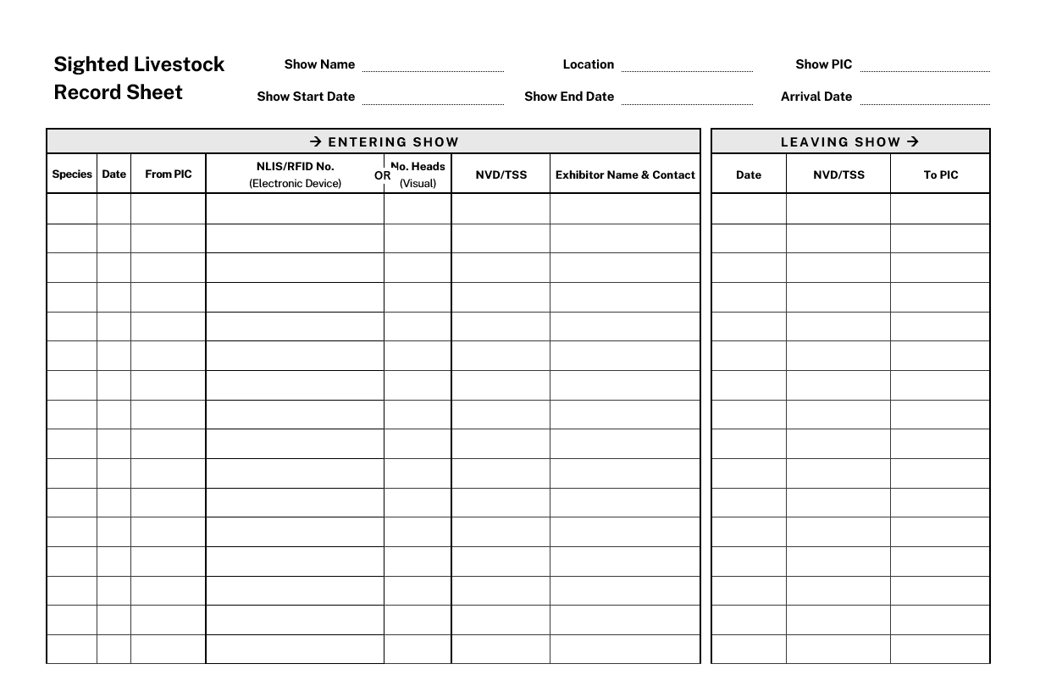
Livestock Movement Records Note: these records must be typed if being sent to AgShows NSW or DPIRD
Note: you must be able to relate the RFID’s/ eID’s to their respective NVD.

Slide 16
Uploading livestock movements methods
Method 2. Property-to-Property (P2P)
Only use this method if:
Livestock are moved to a different property after the event, or
Livestock are moved directly to another event, or
Livestock remained at the event for more than three days.
In these scenarios, two P2P transfers must be recorded in the NLIS Database:
From the PIC where the journey commenced (before the event) to the event PIC, and
From the event PIC back to the original PIC or to a new destination PIC

Slide 17
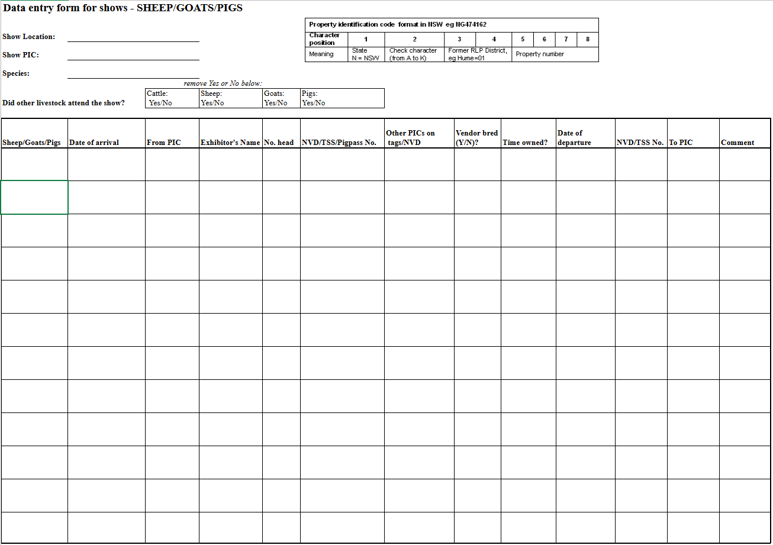
These can be found on agshowsnsw.org.au website – used for non-eID sheep/ goats only

Slide 18
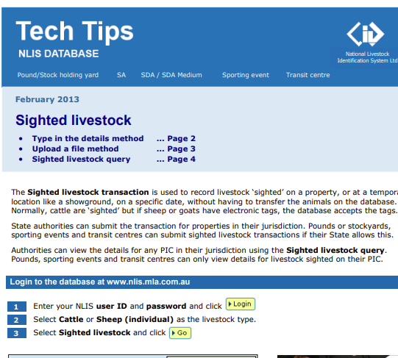
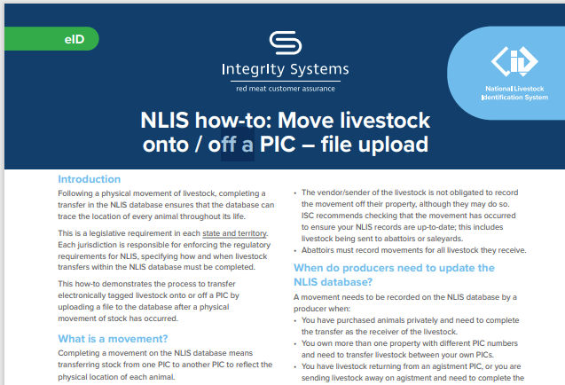
Tech Tips available on NLIS account under Help

Slide 19
DPIRD - supporting NLIS requirements
Transition to individual livestock recording
Event organisers will be responsible for NLIS data uploads by 1 January 2027
All Mob-based movements will be phased out
All spreadsheet submissions to DPIRD will be phased out
Transition support is available
Over the next two years, NSW DPIRD will:
Provide guidance and training to build capability
Share resources
Improve confidence with using the NLIS database including NLIS 2.0
Recommend learning from shows and events e-learning module
Receive feedback on how we can support your event during the transition phase

Slide 20
Sources of information and assistance
AgShows NSW can help with:
Checklists for stewards, committee members and producers
Livestock movement record sheet templates
agshowsnsw.org.au ph: 02 9879 6777
Integrity Systems Company (ISC) can help with:
NLIS database uploads or errors
NLIS ‘how to’ guides
SPORTEVENT account set up and log in
support@integritysystems.com.au ph:1800 683 111
NSW DPIRD can help with:
Understanding your NLIS obligations
Transition period to shows uploading their own movements
Livestock.traceability@dpird.nsw.gov.au or
Ph: 1300 720 405
Local Land Services (LLS) can help with:
Property Identification Codes (PIC) information
May be able to assist with your show scanning
lls.nsw.gov.au or ph: 1300 795 299

